Slide 1


MODULE 2
Literature Review and Technical Reading, Attributions and Citations
VIDYA VIKAS INSTITUTE OF ENGINEERING AND TECHNOLOGY
DEPARTMENT OF INFORMATION SCIENCE AND ENGINEERING
Prepared By:
Akash D
Assistant Professor
Dept. of ISE
VVIET, MYSORE

Slide 2
Literature review and Technical Reading
LITERATURE REVIEW
The primary goal of literature review is to know the use of content/ideas/approaches in the literature to correctly identify the problem that is known beforehand.
To advocate a specific approach adapted to understanding the problem, and to access the choice of methods used.
It also helps the researcher understand clearly that the research to be undertaken would contribute something new and innovative.
The quality of such review can be determined by evaluating if it includes appropriate breadth and depth of the area under study, clarity, rigor, consistency, effective analysis.

Slide 3
Literature review and Technical Reading
NEW AND EXISTING KNOWLEDGE
New knowledge in research can only be interpreted within the context of what is already known, and cannot exist without the foundation of existing knowledge.
The new knowledge can have vastly different interpretations depending on what the researcher‘s background, and one‘s perception of that new knowledge can change from indifference to excitement (or vice versa), depending on what else one knows.
The existing knowledge is needed to make the case that there is a problem and that it is important
One can infer that the knowledge that is sought to be produced does not yet exist by describing what other knowledge already exists and by pointing out that this part is missing so that what we have is original.

Slide 4
Literature review and Technical Reading
Often, but not always, the textbooks contain the older established knowledge and the research papers the newer work.
The review process must explain how a research item builds on another one. An effective review of literature ensures a firm foundation for advancing knowledge, facilitates theoretical growth, eliminates as areas that might be off interest, and opens new avenues of possible work
A good literature survey is typically a two-step process as enumerated below:
o Identify the major topics or subtopics or concepts relevant to the subject under consideration.
o Place the citation of the relevant source (article/patent/website/data, etc.) in the correct category of the concept/topic/subtopic

Slide 5
Literature review and Technical Reading
ANALYSIS AND SYNTHESIS OF PRIOR ART
A prior art search means looking for any existing knowledge, publications, patents, or products that are already available before your invention or idea.
After collecting the sources, usually articles, intended to be used in the literature review, the researcher is ready to break down each article and identify the useful content in it, and then synthesize the collection of articles.
A researcher should analyze the relevant information ascertained in below table by undertaking the following steps:
Understanding the hypothesis,
Understanding the models and the experimental conditions used,
Making connections,
Comparing and contrasting the various information, and
Finding out the strong points and the loopholes.

Slide 6
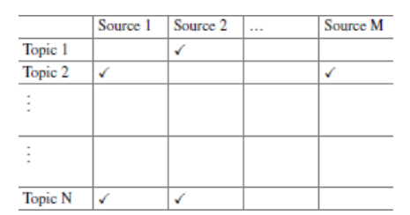
Literature review and Technical Reading
A literature survey grid of N topics and M sources is shown above to help crystallize the information in different categories.
The goal of literature survey is to bring out something new to work on through the identification of unsolved issues, determine the problems in the existing models or experimental designs, and present a novel idea and recommendations

Slide 7
Literature review and Technical Reading
Relying on refereed articles published in scholarly journals or granted patents can save the researcher a lot of time.
Here are a few criteria that could help the researcher in the evaluation of the information under study:
Authority: What are the author‘s credentials and affiliation? Who publishes the information?
Accuracy: Based on what one already knows about the topic or from reading other sources, does the information seem credible? Does the author cite other sources in a reference list or bibliography, to support the information presented?
Scope: Is the source at an appropriate comprehension or research level?

Slide 8
Literature review and Technical Reading
BIBLIOGRAPHIC DATABASES
Bibliographic database is an organized collection of references (like titles, authors, abstracts, keywords, etc.) of published works such as research papers, books, journals, or articles.
Examples
Scopus – index of journals, conference papers.
Web of Science – references of research articles from top journals.
PubMed – database of medical/life sciences research papers.
IEEE Xplore (Institute of Electrical and Electronics Engineers) – references of engineering and computer science papers.

Slide 9
Literature review and Technical Reading
WEB OF SCIENCE
Web of Science (formerly known as ISI or Thomson Reuters) includes multiple databases, as well as specialized tools.
It is a good search tool for scholarly materials requiring institutional license and allows the researcher to search in a particular topic of interest, which can be made by selection in fields that are available in drop down menu such as title, topic, author, address, etc.
The tool also allows sorting by number of citations (highest to lowest), publication date.
On clicked website provides the title of the paper, authors, the type of journal, volume, issue number and year of publication, abstract keywords.

Slide 10
Literature review and Technical Reading
Google
Google is a great place to start one‘s search when one is starting out on a topic. It can be helpful in finding freely available information, such as reports from governments, organizations, companies, and so on.
limitations:
It‘s a ―black box of information. It searches everything on the Internet, with no quality control—one does not know where results are coming from.
There are limited search functionality and refinement options.

Slide 11
Literature review and Technical Reading
Google Scholar
Google Scholar limits one‘s search to scholarly literature. Databases provide access to journal articles and conference proceedings, as well as other scholarly resources. However, there are limitations:
Some of the results are not actually scholarly.
An article may look scholarly at first glance, but is not a good source upon further inspection.
it is not comprehensive. Some publishers do not make their content available to Google Scholar.
There are limited search functionality and refinement options.

Slide 12
Literature review and Technical Reading
EFFECTIVE SEARCH: THE WAY FORWARD
A scholarly publication is one where in the published outcome is authored by researchers in a specific field of skill. Such work cites all source contents used and is generally peer reviewed for accuracy and validity before publication.
Essentially, the audience for such works is fellow experts and students in the field. The content is typically more complex and advanced than those found in general magazines.
A researcher must consider what type of information is needed, and where it could be found. Not all information is available online. Some information is only available in print, It can take time for scholarly and peer-reviewed information to be published.

Slide 13
Literature review and Technical Reading
Searching is an iterative process:
Experiment with different keywords and operators
Evaluate and assess results, use filters
Modify the search as needed
When relevant articles are found, look at their citations and references.
After the search is complete, the researcher needs to engage in critical reading, making observation of the salient points in those sources, and summarize the findings.

Slide 14
Literature review and Technical Reading
A detailed comparison and contrast of the findings is also required to be done. This entire process may be needed to be done multiple times
One must note that the literature survey is a continuous and cyclical process that may involve the researcher going back and forth till the end of the research project. Nothing will come of it unless one is an active reader and spends sufficient time to develop one‘s own ideas build on what one has read.
It is not as if literature survey ends and then research begins, for new literature keeps appearing, and as one‘s understanding of the problem grows, one finds new connections and related/evolving problems which may need more search.

Slide 15
Literature review and Technical Reading
Critical Reading
Reading a research paper is a critical process.
The reader should not be under the assumption that reported results or arguments are correct.
Rather, being suspicious and asking appropriate questions is in fact a good thing.
Have the authors attempted to solve the right problem?
Are there simpler solutions that have not been considered?
What are the limitations (both stated and ignored) of the solution and are there any missing links?
Are the assumptions that were made reasonable?
Is there a logical flow to the paper or is there a flaw in the reasoning?

Slide 16
Literature review and Technical Reading
Critical Reading
Use of judgemental approach and boldness to make judgments is needed while reading.
it is important to ascertain whether the data presented in the paper is right data and whether the data was gathered and interpreted in a correct manner.
It's crucial to determine if using a different dataset could have made the research more convincing and compelling.
Critical reading is relatively easy.
It is relatively easier to critically read to find the mistakes than to read it so as to find the good ideas in the paper.
Anyone who has been a regular reviewer of journal articles would agree to such a statement.

Slide 17
Literature review and Technical Reading
Creative Reading
Reading creatively is harder, and requires a positive approach in search.
In creative reading, the idea is to actively look for other applications, interesting generalizations, or extended work which the authors might have missed?
Are there plausible modifications that may throw up important practical challenges?
To decide if you want to go deeper into your work, consider evaluating whether there's potential for extended research. The immediate focus should be on identifying the next aspect that warrants exploration.

Slide 18
Literature review and Technical Reading
Taking Notes While Reading
A researcher reads to write and writes well only if the reading skills are good.
The bridge between reading and actually writing a paper is the act of taking notes during and shortly after the process of reading.
There is a well-known saying that writing is better than the best memory, and it applies to researchers who need to read and build on that knowledge to write building on the notes taken.
Many researchers take notes on the margins of their copies of papers or even digitally on an article aggregator tool. Examples: Google Scholar, ResearchGate, Mendeley, Zotero.

Slide 19
Literature review and Technical Reading
Taking Notes While Reading
In each research paper, there are a lot of things that one might like to highlight for later use such as definitions, explanations, and concepts.
If there are questions of criticisms, these need to be written down so as to avoid being forgotten later on.
Such efforts pay significantly when one has to go back and reread the same content after a long time

Slide 20
Literature review and Technical Reading
Taking Notes While Reading
On completing a thorough reading, a good technical reading should end with a summary of the paper in a few sentences describing the contributions.
But to explain the technical merit, the paper needs to be looked at from comparative perspective with respect to existing works in that specific area.
A thorough reading should bring out whether there are new ideas in the paper, or if existing ideas were implemented through experiments or in a new application, or if different existing ideas were brought together under a novel framework.
Obviously, the type of contribution a paper is actually making can be determined better by having read other papers in the area

Slide 21
Literature review and Technical Reading
Reading Mathematics and Algorithms
Mathematics is often the foundation of new advances, for evolution and development of engineering research and practice.
An engineering researcher generally cannot avoid mathematical derivations or proofs as part of research work.
In fact, these are the heart of any technical paper. Therefore, one should avoid skimming them.
By meticulous reading(close attention to every small detail) of the proofs or algorithms, after having identified the relevance of the paper, one can develop sound understanding about the problem that the authors have attempted to solve.

Slide 22
Literature review and Technical Reading
Reading Mathematics and Algorithms
However, researchers may skip a technical section if it appears to explain something already known, is too advanced for their current research, or seems highly specialized and unnecessary for their current project.
When implementing algorithms in programming languages like C, C++, or Java, errors are common.
Even with confidence in the paper and the algorithm, coding it quickly to check its functionality is a prudent step, as there's a fair chance it may not work as expected.

Slide 23
Literature review and Technical Reading
Reading a Datasheet
Researchers in different fields of engineering will need to read certain types of documents.
For example, mechanical and civil engineers would need to read drawings related to mechanical parts and buildings.
Researchers in the field of electronics need to read datasheets.
On occasions, researchers in other fields may also need to incorporate a certain electronic part in which case careful reading of the datasheet is imperative.

Slide 24
Literature review and Technical Reading
The same principles like initial skimming(surface-level reading) of the datasheet are required to ascertain whether further careful reading is needed.
Datasheets are instruction manuals for electronic components, which (hopefully) details what a component does and how one may use it.
Datasheets enable a researcher (or a working professional) to design a circuit or debug any given circuit with that component.
The first page of the datasheet usually summarizes a part's function and features, basic specifications, and usually provides a functional block diagram with the internal functions of the part.

Slide 25
Literature review and Technical Reading
Datasheets usually end with accurate dimensions of the packages a part is available in.
When working with a new part, or when deciding which part to use in the research work, it is recommended to carefully read that part's datasheet to come up with a bit of shortcut that may potentially save many hours later on.
Technical published papers or books are not the only contents that a researcher has to master reading!
Use datasheets as an example to state the need to pay attention to the art of reading such documents.

Slide 26
Literature review and Technical Reading
Giving Credit Wherever Due
Academic writing, by definition, must follow certain rules and conventions.
Among the most important of these are the rules and conventions about citing, referencing, attributing, and acknowledging the works of others.
That means giving proper credit wherever due. Citing is the practice of quoting from, referring to other authors' works and ideas in the text of our work in such a way that the context is clear to the reader.
Referencing is the listing of the full publication details of a published work that is cited so as to give background information to the readers.

Slide 27
Literature review and Technical Reading
Acknowledgment in research publications indicates contributions to scientific work.
However, acknowledgment, attributions, and citations differ in the manner of their application.
Acknowledgment is arguably more personal, singular, and simply an expression of appreciations and contribution.

Slide 28
Literature review and Technical Reading
Simple one-line difference:
Citing → Briefly mention inside the text
Example 1: Artificial Intelligence is transforming industries [1].
Example 2: Artificial Intelligence is transforming industries (Smith, 2020).
Referencing → Full details of the source in the reference list/bibliography.
Attributing → Giving credit to the original creator of an idea, data, or work.
Acknowledging → Thanking or recognizing contributions, support, or help (not always academic sources).

Slide 29
Literature review and Technical Reading
Citations: Functions and Attributes
Citations (references) credit others for their work, while allowing the readers to trace the source publication if needed.
Any portion of someone else's work or ideas in papers, patents, or presentations must be used in any new document only by clearly citing the source.
This applies to all forms of written sources in the form of texts, images, sounds, etc. and failure to do may be considered plagiarism (copied).
Materials that can be cited include journal papers, conference proceeding, books, theses, newspaper articles, websites, or other online resources and personal communication.

Slide 30
Literature review and Technical Reading
Preferably, citations should be given at the end of a sentence or the end of a paragraph [1].
A researcher needs to cite each source twice:
(i) in-text citation, in the text of the article exactly where the paraphrased, and source is quoted or
(ii) a second time in the references, typically at the end of the chapter or a book or at the end of a research art

Slide 31
Literature review and Technical Reading
There are three main functions of citation:
1. Verification function: Authors have a scope for finding intentional or unintentional distortion of research or misleading statements. Citation offers the readers a chance to ascertain if the original source is justified or not, and if that assertion is properly described in the present work.
2. Acknowledgment function: Researchers primarily receive credit for their work through citations. Citations play crucial role in promotion of individual researchers and their continued employment. Many reputed organizations and institutes provide research funding based on the reputations of the researchers. Citations help all researchers to enhance their reputation.

Slide 32
Literature review and Technical Reading
Example:
Suppose Dr. Ramesh publishes a research paper on AI in Healthcare.
Later, 20 other researchers write their own papers and cite Dr. Ramesh ’s paper as a source.
Because his work is cited many times, it shows that her research is important and valuable.
When he applies for a promotion or research funding, the committee sees that his paper has 20 citations → this increases his chances of getting funding or a higher position.
3. Documentation function: Citations are also used to document scientific concepts and historical progress of any particular technology over the years.
Citations are the currency that authors would wish to accumulate and the technical community gives them credit for these contributions. When other authors make citations, they honor those who initiated the ideas.

Slide 33
Literature review and Technical Reading
There are certain cases when references do not fulfill the actual goal of citations and acknowledgments, and thus do not benefit the reader.
Some of them are motioned below:
1. Spurious citations- citation is not required/ not found
2. Biased citations-cite the work of their friends or colleagues with no relevance
3. Self-citations- Can be done only if work is relevant.
4. Coercive citations- involve pressuring researchers to include unnecessary references in their work
From the above discussions, it is clear that the author(s) must maintain a balance between too few and too many citations. At the same time, author(s) must give credit whenever due even if it is their own work.

Slide 34
Literature review and Technical Reading
Impact of Title and Keywords on Citations
The citation rate of any research paper depends on various factors including significance and availability of the journal, publication types, research area, and importance of the published research work.
Other factors like length of the title, type of the title, and selected keywords also impact the citation count.

Slide 35
Literature review and Technical Reading
The title of a research paper is a critical attribute, serving as the primary indicator of the research area and aiding researchers in literature surveys.
It plays a pivotal role in marketing, making papers traceable and accessible.
A good title should not only be informative and represent the paper effectively but also capture the readers' attention.
However, some titles may be informative without engaging readers, while others are attractive but lack relevance to the readers' research area

Slide 36
Literature review and Technical Reading
The impact of a research paper's title goes beyond its initial presentation.
The download count and citation rates may be influenced by the title, introducing three key aspects that shape its behavior:
(i) types of the title - Descriptive vs. Question vs. Declarative.
(ii) length of the title - Short titles often attract more citations than very long ones.
(iii) the presence of specific markers - The use of colons, question marks, or terms like “Review” or “Case Study” can affect visibility.
Striking a balance between informativeness, attractiveness, and relevance in the title is essential for maximizing the paper's visibility, accessibility, and impact within the academic community.

Slide 37
Literature review and Technical Reading
Research on title characteristics and citation rates reveals noteworthy insights.
Stremersch et al. [11] examined papers in the 1990-2002 research domain, finding a positive correlation between title length and citation counts.
Sagi and Yechiam [12] discovered that highly amusing titles receive fewer citations, while pleasant titles show no significant relation to citations.
Jacques and Sebire [8] analyzed titles from highly and least-cited papers, uncovering a robust association between longer titles and increased citation rates.
Jamali and Nikzad [13] observed that question- type titles lead to higher downloads but lower citations, and declarative titles are downloaded and cited less than descriptive titles, although the difference is not substantial.

Slide 38
Literature review and Technical Reading
In general, titles containing a question mark, colon, and reference to a specific geographical region are associated with lower citation rates, also result-describing titles usually get citations than method-describing titles.
Keywords are crucial components of an article, encapsulating essential information relevant to the research area.
Utilized by search engines, journals, digital libraries, and indexing services, keywords categorize the research topic, directing the work to its intended audience.

Slide 39
Literature review and Technical Reading
Their significance lies in ensuring readers are informed about the article's content [15].
Maximizing allowable keywords enhances the article's discoverability and increases the likelihood of citation.
However, introducing new, unfamiliar keywords should be minimized to prevent low visibility within the research community.
Knowledge flow happens between co-authors during research collaboration, among other researchers through their paper citation network, and also between institutions, departments, research fields or topics, and elements of research [17].
Figure 1 shows the relationship between citations, knowledge flow, and elements such as researchers, papers, journal publications or conferences, and institutions.
If paper A is cited by paper B, then knowledge flows through citation networks across institutions.

Slide 40
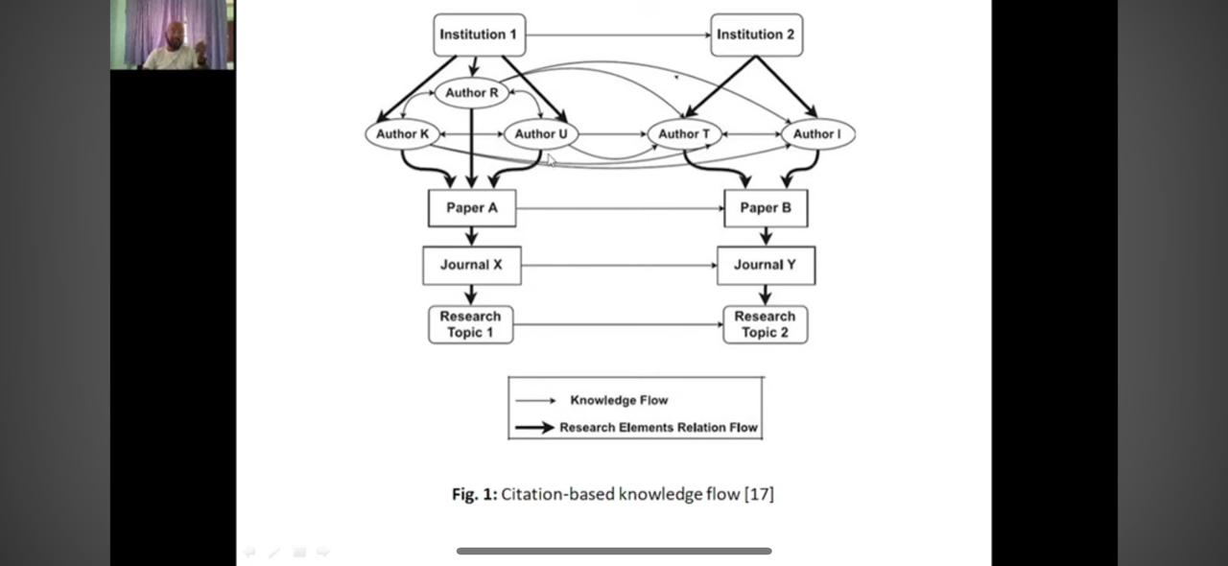
Literature review and Technical Reading

Slide 41
Literature review and Technical Reading
Sooryamoorthy [18] examined the citation impact of the South African publications among different collaboration types, discipline and sectors, and observed that co-authored publications had more citations than single author paper and there was a positive co- relation between number of authors and the number of citations [18].
Figure 2 shows a relationship between co- authorship and different types of citations.
Three articles (X, Y, and Z) and five references (X1, X2, X3, Y1, and Y2) of article X and Y, respectively, are considered. A, B, and C are authors of article X, and D, E, F, G, and also A are authors of article Y. Article Z has two authors H and E. References X1, X2, X3, Y1, and Y2 have authors (A, P), (H, R), (D), (Q, B, F), and (R), respectively

Slide 42
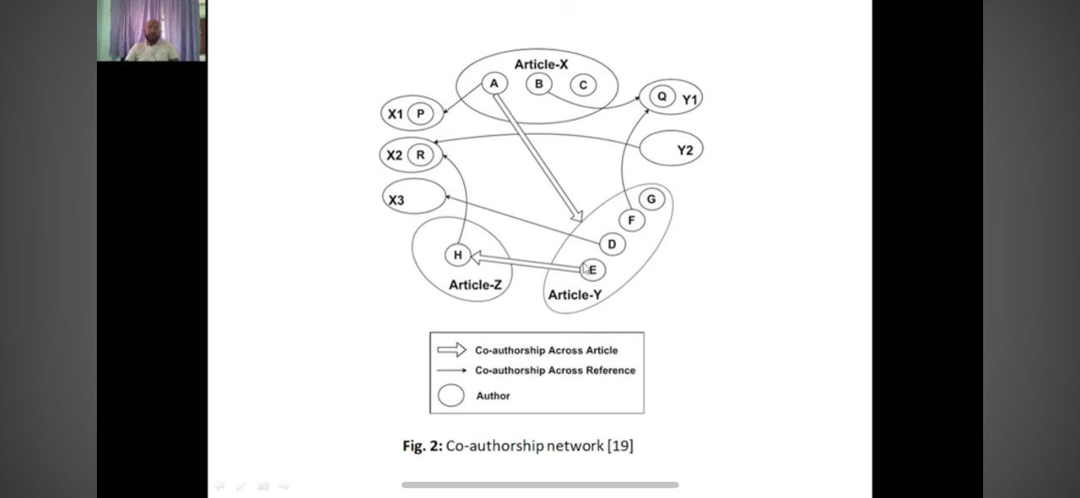
Literature review and Technical Reading

Slide 43
Literature review and Technical Reading
Based on co-authorship citation network, references X1 and Y1 are considered self-citation, reference X3 is a level-1 co-author citation because author of article Y is direct collaborator of author A, reference X2 is a level-1 co-author network because author A is collaborator of E who collaborated with H.
We conclude that papers which frequently cite collaborators will also often cite collaborators of collaborators.
Collaborations certainly impact citation counts

Slide 44
Literature review and Technical Reading
Citing Datasets
The nature of engineering research has evolved rapidly and now relies heavily on data to justify claims and provide experimental evidences and so data citations must fetch proper credit to the creator of the dataset as citations of other objects like research articles.
Ascertaining the ownership of data can be a complicated issue especially with large datasets, and issues of funding can also make it a difficult matter.
A researcher should obtain necessary permission for using data from a particular source.
Citations related to datasets should include enough information so that a reader could find the same dataset again in the future.

Slide 45
Literature review and Technical Reading
Examples:
Historical Data, Sotavento (Wind Farm), Corunna, Spain (July 2016): Retrieved from http://www.sotaventogalicia.com/en/real-time-data/ historical
Deb, D (2016). [Personnel survey].Unpublished raw data.

Slide 46
Literature review and Technical Reading
Styles for Citations
Citation styles differ primarily in the order, and syntax of information about references, depending on difference in priorities attributed to briefness, readability, dates, authors, and publications.
Some of the most common styles for citation (as well as other aspects of technical writing) used by engineers are as follows:
1. ASCE style (American Society of Civil Engineers)
2. IEEE style (Institute of Electrical and Electronics Engineers)
3. ASME style (The Association of Mechanical Engineers)

Slide 47
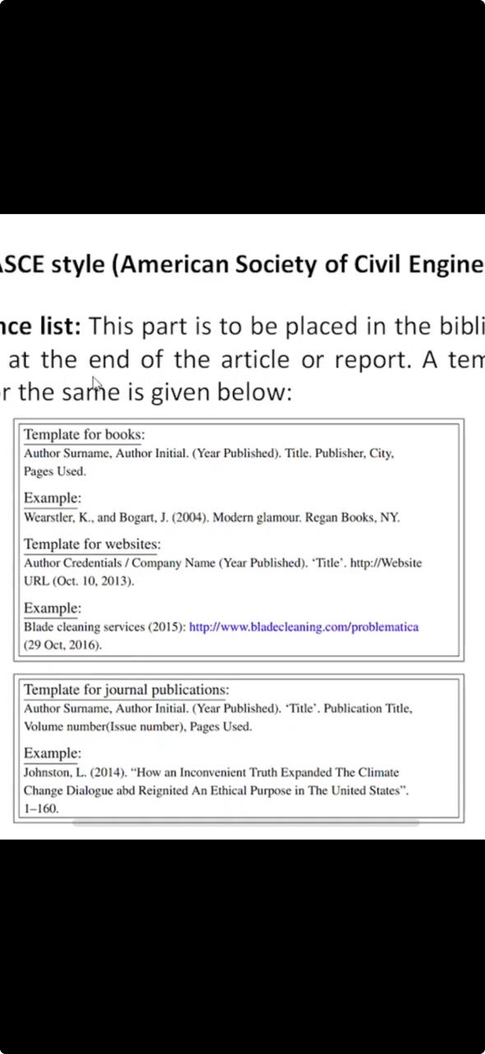
ASCE style (American Society of Civil Engineers)
(a) Reference list: This part is to be placed in the bibliography or references at the end of the article or report. A template with example for the same is given below:

Slide 48
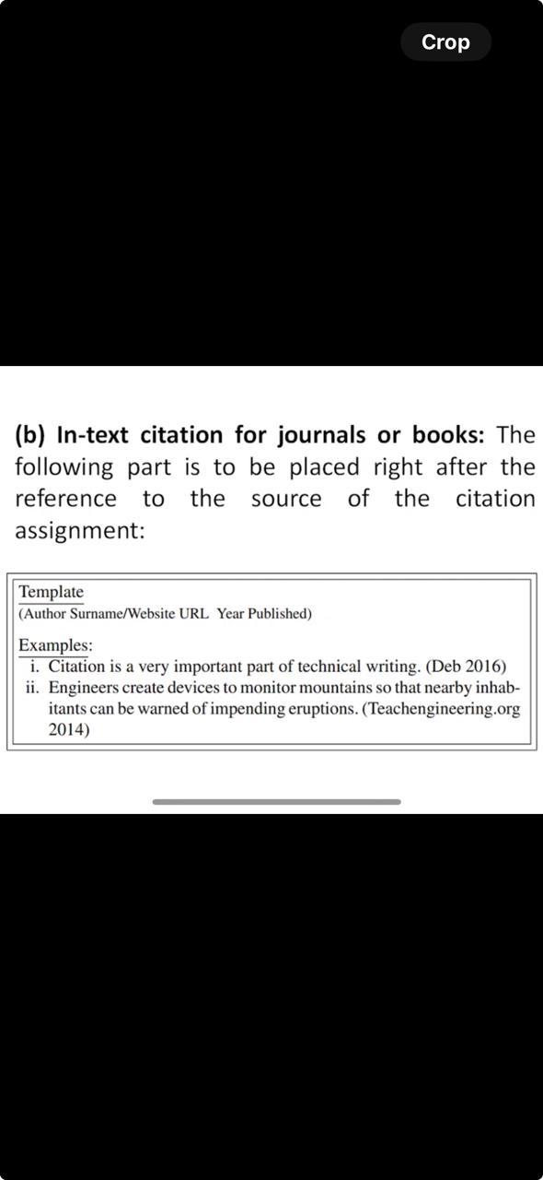
Literature review and Technical Reading
(b) In-text citation for journals or books: The following part is to be placed right after the reference to the source of the citation assignment:

Slide 49
Literature review and Technical Reading
2. IEEE style (Institute of Electrical and Electronics Engineers)
IEEE style is standard for all IEEE journals and magazines, and is frequently used for papers and articles in the fields of electrical engineering and computer science.
The lEEE style requires endnotes and that references be cited numerically in the text.
Those submitting to an IEEE publication should see guidelines for the specific journal or magazine and may also refer to the complete lEEE editorial style manual.

Slide 50
Literature review and Technical Reading
Some examples of IEEE styles of citations for different types of sources are enumerated below:
Chapter in an edited book
[1] A. Rezi and M. Allam, "Techniques in array processing by means of transformations in Control and Dynamic Systems”, Vol. 69, Multidimensional Systems, C. T. Leondes, Ed. San Diego: Academic Press, 1995, pp. 133-180.
For more details: http://www.ieee.org/documents/style manual.pdf

Slide 51
Literature review and Technical Reading
3. ASME style
Author, AA., Author B.B, and Author, C.C, Year, "Title of Technical Report”, Agency Name Report Number
Example:
Shareef, J. U., Navya R. M., Anand S., and Dinesh R. 2017 "Synthesis and characterization of silver nanoparticles from Penicillium sps." Materials Today: Proceedings 4, no. 11: 11923-11932.
https://www.asme.org/shop/proceedings/conference-publications/references

Slide 52
Literature review and Technical Reading
15. Acknowledgments and Attributions
The acknowledgment section serves as a platform to express gratitude for contributions made by individuals, organizations, or funding bodies to the current work.
When specific guidelines are lacking, it can be included at the end of the text or as a footnote.
This practice is common in recognizing those responsible, in various capacities, for the completion of publishable research outcomes.

Slide 53
Literature review and Technical Reading
Acknowledgments highlight relationships among people, agencies, institutions, and research, allowing gratitude for those who may not be included as authors but have contributed to the work.
Acknowledgments can be classified into six categories: moral, financial, editorial, institutional, technical, and conceptual support.
Acknowledgments and attributions are also very important in the publications of journal or conference papers.

Slide 54
Literature review and Technical Reading
Giving proper credit wherever it is due is very important and even if the contribution is minor, it should not be neglected
The reward triangle theory shows a relationship between citations, acknowledgment and authorship.
In engineering research, acknowledgments are meant for participating technicians, students, funding agency, grant number, institution, or anyone who provide scientific inputs, shared unpublished results, provided equipment, or participated in discussions.

Slide 55
Literature review and Technical Reading
15.1. What Should Be Acknowledged?
Every author should know that what should/should not be acknowledged.
Author should acknowledge funding organization, oral discussion or support, laboratory, and computer work.
Remove Quataions
(i) Scientific or technical guidance: Authors must acknowledge those providing scientific or technical guidance, participating in discussions, or sharing information. The recognition extends to assistants, students, or technicians who contributed experimentally and theoretically to the research work.

Slide 56
Literature review and Technical Reading
(ii) Funding/Grants: If the researcher received grant from a funding agency and if those funds were used in the work reported in the publication, then such support should always be acknowledged by providing full details of the funding program and grant number in the acknowledgment section.
An example of acknowledgment of grant received is as follows: Acknowledgments: This research work was funded in part by the Extra Mural Research Funding 2014-17 (Individual Centric) of the Department of Science and Tech-nolgy (DST), Govt. of India.

Slide 57
Literature review and Technical Reading
(iii) Acknowledging that results have been presented elsewhere: When acknowledging that results have been presented elsewhere, Acknowledge the journal if presented as an abstract.
For presentations in scientific meetings(conferences) or symposia, include relevant details such as the event's name, year, location, and date.
This provides concise acknowledgment of the previous presentation of the results.

Slide 58
Literature review and Technical Reading
15.2. Acknowledgments in Books / Dissertations
Thesis or dissertation acknowledgments, placed after the table of contents, are more extensive than those in journal papers or conference articles.
They allow researchers to express gratitude to all contributors.
Consideration should be given to the order and brief expression, avoiding emotional language.
Common acknowledgments include supervisors, peers, academic staff, technical support, colleagues, institutions, family, and friends.

Slide 59
Literature review and Technical Reading
Sample Acknowledgement in Thesis:
I wish to express my sincere appreciation to my supervisor Prof. (Dr.) Syed Akheel Ahmed for the useful comments, remarks and encouragement throughout this thesis work.
Furthermore, I wish to express my thanks to Dr. Prasad P., for supervising and Dr. Syed Noeman Taqui for introducing me to the topic and for the support along the way.
Also, I like to thank my friends in the Dr. Syed Usman Taqui & Bhavana Alke, who have shared their precious time during many technical discussions and Lab assistant Kiran.
I would like to thank my family members who have supported me throughout this journey in many different ways.

Slide 60
Literature review and Technical Reading
16. Dedication or Acknowledgments?
Dedication is almost never used in a journal paper, an article in a conference proceedings, or a patent, and it is used exclusively in larger documents like books, thesis, or dissertations.
While acknowledgments are reserved for those who helped out with the book in some way or another (editing, moral support, etc), a dedication is to whomever the author would like it to be dedicated to, whether it is the author's mother, the best friend, the pet dog, or Almighty God.
And yes, it is possible to dedicate something to someone while also mentioning them in the acknowledgments.

Slide 61
Literature review and Technical Reading
For example, one may dedicate a book to one's spouse, but acknowledge them for being the moral support and putting up with when one got very stressed.
The acknowledgments in technical books can be sometimes as brief as the ones in journal articles.
The acknowledgment section of a technical report may be a paragraph that is longer than a journal paper but shorter than dissertations.
Generally, the length of the acknowledgment may have some correlation with the length of the document.

